Slide 1
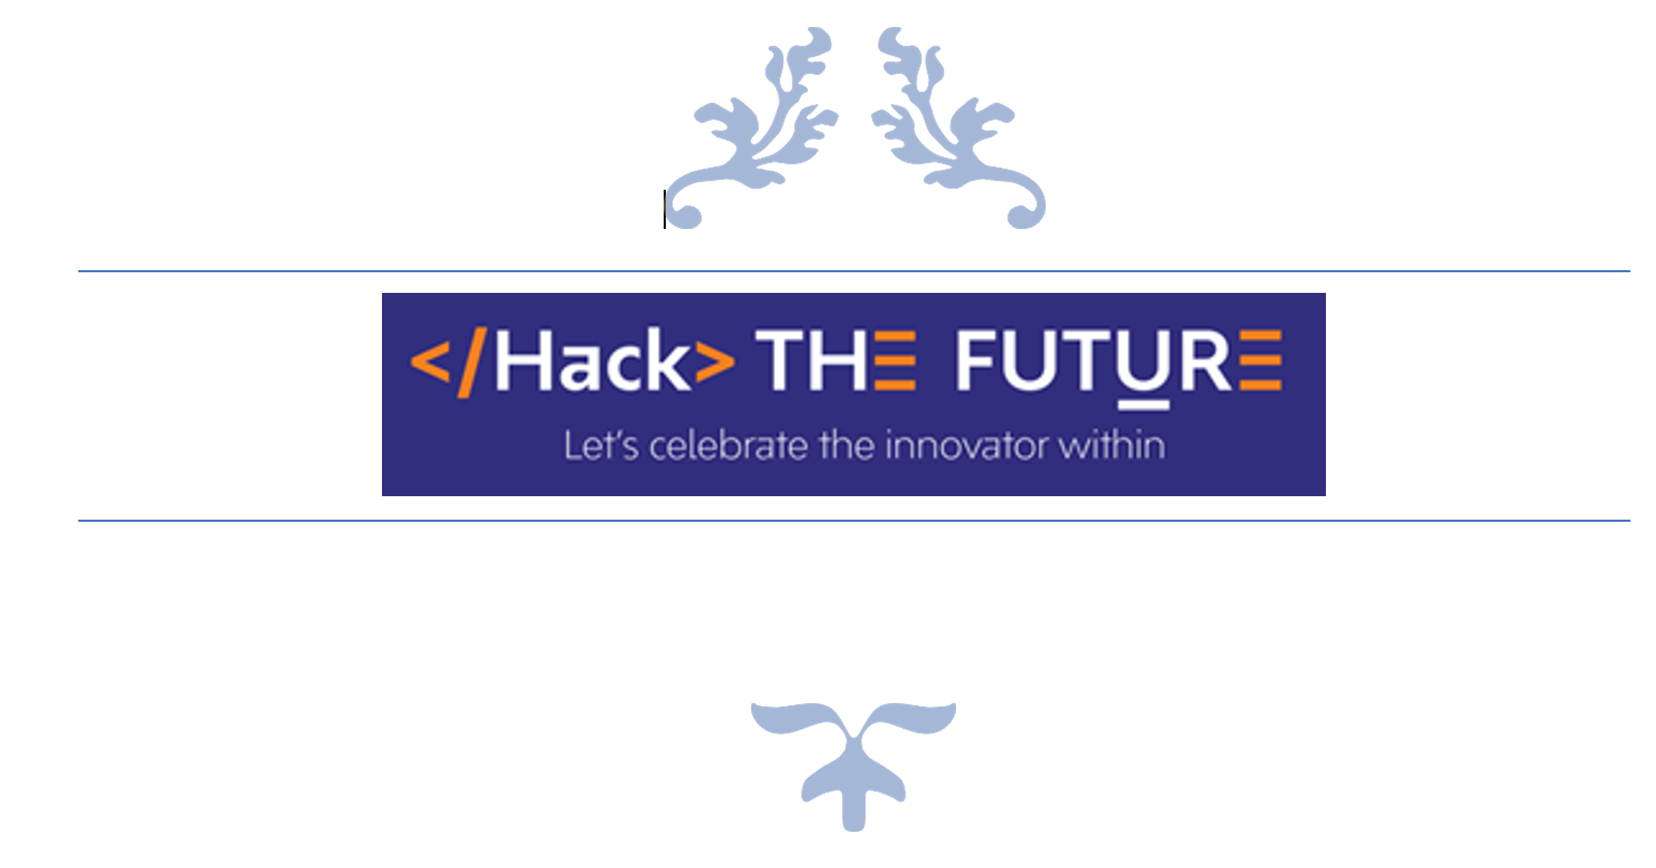
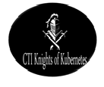
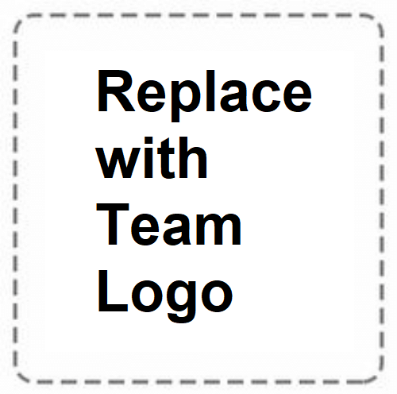

TEAM NAME:
CTI KNIGHTS OF KUBERNETES

Slide 2
Problem Statement
Infrastructure as code meaning all the elements of infrastructure are available as code and can be created & torn down on demand

Slide 3
Describe your solution
Why infrastructure as code?
Codify everything - All infrastructure specifications should be explicitly coded in configuration files
Maintain version control - These configuration files should be version-controlled. Because all configuration details are written in code, and any changes to the codebase can be managed, tracked, and reconciled.
Continuously test, integrate, and deploy - Continuous testing, integration, and deployment processes are a great way to manage all the changes that may be made to your infrastructure code.
Make your infrastructure code modular - You can break down your infrastructure into separate modules or stacks then combine them in an automated fashion.
Make your infrastructure immutable (when possible) - Making your infrastructure immutable provides consistency, avoids configuration drift, and restricts the impact of undocumented changes to your stack.
Features
Providing a single toolset for infrastructure, managed services, containers, and serverless environments on any cloud infrastructure
Productive, expressive use of general-purpose programming languages
Continuous delivery for cloud native infrastructure
Technology Stack used
Tools Used: Kubernetes, NPM, Open Source Tool
VCR: GitHub
Platform: IBM Cloud

Slide 4
Use Cases & Business Value of the solution
To build and deploy Kubernetes based guestbook application with proposed Open source Tool
Objectives:
Start up a Redis leader
Start up Redis replicas
Start up the guestbook frontend
Expose and view the frontend service
Clean up
Business Benefits:
Proposed Open Source Tool makes multi-cloud, multi-technology targeting a reality with a consistent programming model in real languages
It brings the existing power of real programming languages to cloud native infrastructure and application delivery for huge productivity and collaboration gains
It rewrites the rulebook on CI/CD by connecting application code and infrastructure code at the code base, unlocking new workflows to deliver cloud native infrastructure as code.

Slide 5
What was accomplished
We deployed The guestbook Application as multi-tier web application that uses Redis and Nginx powered by Kubernetes.
The primary difference between this Application example and the standard Kubernetes one is that we would be authorising it in TypeScript instead of YAML.
The Deployment part is done by an Open Source Tool rather than Kubectl
This gives us the full power of general-purpose languages, combined with immutable infrastructure, delivering a robust and repeatable update experience

Slide 6
Learnings
Workflow Diagram of Open Source Tool
Write New State
Create, Update, Delete
new Resource()
Last
Deployed
State
CLI and Engine
Cloud Providers
Cloud Providers
Index.ts
Language Host
Cloud Providers

Slide 7
Learnings
Work Flow Explanation
Proposed Open source Tool uses a desired state model for managing infrastructure.
A program is executed by a language host to compute a desired state for a stack’s infrastructure.
The deployment engine compares this desired state with the stack’s current state and determines what resources need to be created, updated or deleted.
The engine uses a set of resource providers (such as AWS, Azure, Kubernetes, and so on.) in order to manage the individual resources.
At last, engine updates the state of your infrastructure with information about all resources that have been provisioned as well as any pending operations.

Slide 8
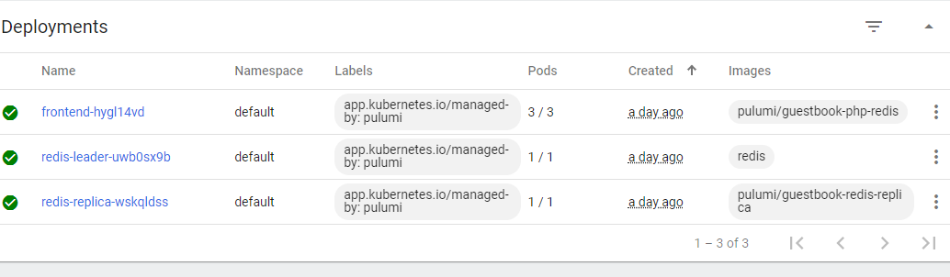
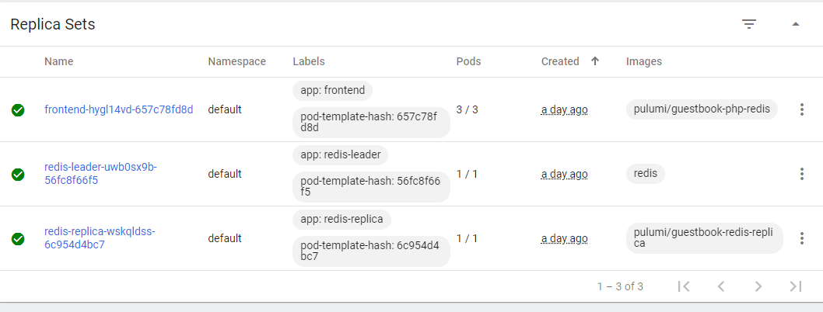
Dashboard view of Guestbook application

Slide 9
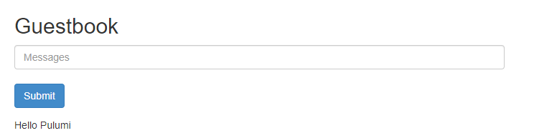
Application View

